Slide 1
Building Administrative Capacity
NCDA Annual Conference
June 22-24, 2022
Victor Turner, Director
Neighborhood Services Department
City of Fort Worth, TX
Notes:
NSD was responsible for over $150M in federal funds via CARES, ARPA, regular federal allocations

Slide 2
Building Capacity
Employee Experience
Notes:
Accountability Measures
Reporting
Transparency
Dashboard Reporting
Interim Roles
Special Projects
Cross Training
New Programs

Slide 3
Employee Experience
What and employee goals align?
In what ways can the employee grow in his/her current position that meets his/her individual growth goal and the organization goal?
What experiences and growth is needed for the employee to prepare for the next position internal or external to the organization?
What are the goals of the employee?
How do the organizational and employee goals align?
In what ways can the employee grow in their current position that will meet the employee’s growth plan and goals as well as the organization’s goal?
What experiences and growth is needed for the employee to prepare for the next position?
What are their needs?
3
Notes:
Expose employees to different programs and projects
(Interim roles; special projects; cross training, etc.)
Use any type or re-organization as an opportunity to align employees with department goals and build administrative capacity

Slide 4
Building Capacity: Performance Management
For each role, do you have a clear job description?
Is important information about each position (general work cycle: major projects, major deadlines, critical issues) documented somewhere?
Are employees participating in regular performance conversations?
Have your job descriptions been updated?
Do you have ongoing performance evaluations that incorporate professional goals for each employee?
Do you have a succession plan in place?
Notes:
In other words, if a key team member quit today could someone else be brought up to speed in an efficient manner?

Slide 5
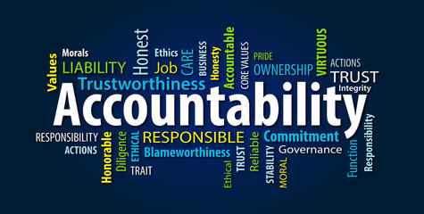
Performance Management
Manager
Employee
Duties
Behaviors
Behaviors
Systems
Outcomes
Notes:
Accountability
When your people are accountable for their own decisions, work, and results, the effectiveness greatly increases. Of the three skills that contribute to driving results, accountability has the power to lift your whole team to higher performance. Holding yourself and others accountable for decisions, actions, timeliness, and quality differentiates a winning team from an average or failing one
Use tools to help employees be accountable (i.e., Project management tools, Smartsheet, etc. for transparency, reporting, dashboarding)

Slide 6
Building Capacity
Development Plans
Utilize staff evaluations as an opportunity to learn about the employee to help them think about their future
Do you offer training and development opportunities for employees on a regular basis?
Understand your employee’s aspirations both internal to the organization or external
Capture strengths, weaknesses and future aspirations to create develop goals that make sense for their development needs
6

Slide 7
Development Plans
Best Practices
7
Notes:
Decide the role that the supervisor will play in the helping the individual accomplish their goals.
Make sure it is in writing so both parties are accountable.
How can it fit into the organizations strategic plan.
Work the development into one-on-ones and quarterly meetings

Slide 8
Step 1
Identify High
Potential Talent
Step 2
Identify Critical Positions or Jobs
Step 3
Create Succession Plans
Building Capacity
Talent Development Process
8
Notes:
Step 1 - People Reviews
9 box assessment tool
Provide feedback and actions for individual development plans
Step 2 - Based on level, business need and/or unique skill
Identify skill gaps in the organization
Plan for the future, not replace the past
Example, CEO – 3 levels below
Step 3 - Three deep benchmarks of possible successors
Identify at risk positions

Slide 9
Talent Development
Talent Review: A deliberate and systematic effort:
Evaluate the complexity of the talent in the organization
Identify a pool of high potential talent
Develop talent through targeted learning experiences
Standardize talent and provide feedback for individual development plans
Create a pipeline of talent for the organization
Discuss and share talent across the organization
Notes:
Critical Jobs & Succession Planning: A formalized process to identify benchmarks' strength for critical positions:

Slide 10
Building Capacity:
Succession Planning
10
Notes:
What is it?
Assessment of current and future needs based on our strategic plan and priorities
Matching these needs to our current workforce
Developing a plan to manage the gaps that will arise when individuals in key positions leave or are promoted
Why is it important?
Maintains continuity when key individuals leave
Creates alignment between our organization’s vision and human resources
Ensures a supply of qualified, motivated people; a process to identify them; and a way to develop them
Develops career paths that will help us retain great staff and send them a message that we value them
What’s success today?
Increase Leadership Team buy-in around succession planning, despite small org size
Create clarity around roles and expectations of process (i.e., leadership team and HR)
Agree upon processes to select individuals for vacancies

Slide 11
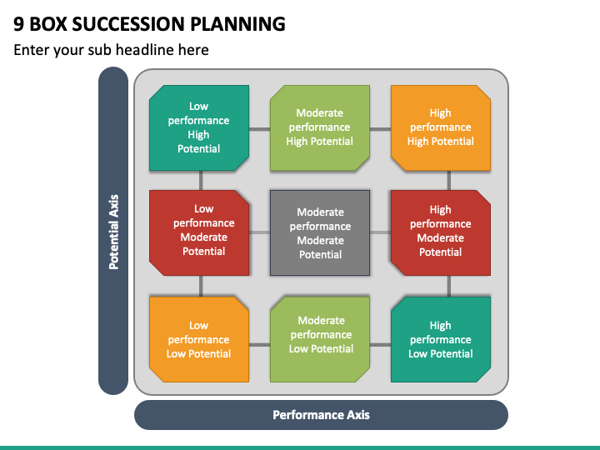

Slide 12
Q&A
Thank you!
12

